Slide 1

Session 12
Files

Slide 2
Working with files in Python

Slide 3
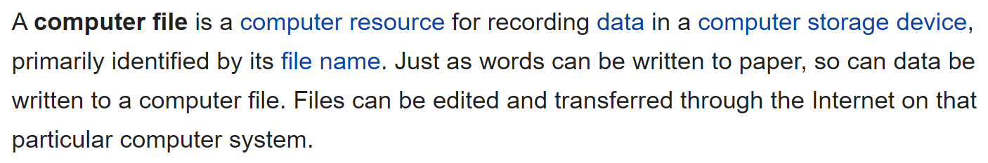

What is a file?

Slide 4
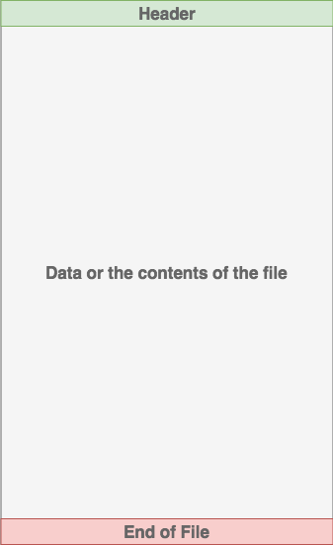
What is a file?
Files on most modern file systems are composed of three main parts:
Header: metadata about the contents of the file (file name, size, type, and so on)
Data: contents of the file as written by the creator or editor
End of file (EOF): special character that indicates the end of the file

Slide 5
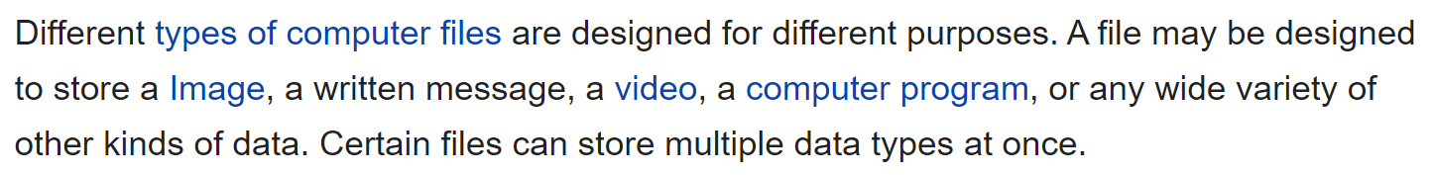
What is a file?

Slide 6







What is a file?
image
audio
video
text
File format: the way that data inside the file is organized
folder
gentlemen.jpg

Slide 7
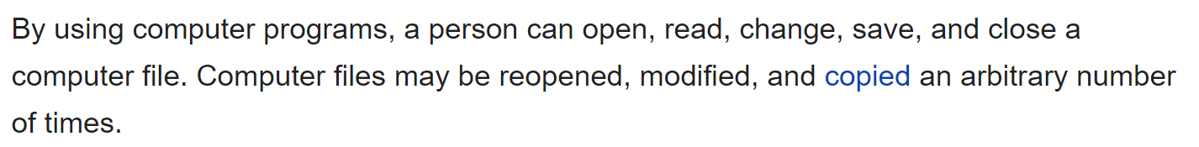
What is a file?

Slide 8


What is file path?
File path is used to access a file on an operating system.
The file path is a string that represents the location of a file. It’s broken up into 3 major parts:
Folder Path: the file folder location on the file system where subsequent folders are separated by a forward slash / (Unix) or backslash \ (Windows)
File Name: the actual name of the file
Extension: the end of the file path pre-pended with a period (.) used to indicate the file type
I want ex1.py file
Can u be more specific?

Slide 9
File path in different OS
Unix
Folder path/file_name.extention
Window
Folder_path\file_name.extention
/Users/mindX/Desktop/ex1.py
C:\Users\mindX\Desktop\ex1.py

Slide 10
Accessing file
variable_name = open(“file_path”, “mode”)
# Do something
variable_name.close()
Text mode
(info stored in form of ASCII or UNICODES)
Binary mode
(info stored in the same format as held in memory)
Warning: You should always make sure that an open file is properly closed.

Slide 11

Accessing file using context manager (recommended)
Using with statement

Slide 12
Open mode
“r”: Open file to read content only. Run alert if file does not exist
“a”: Open file to append more content to the file. Create a new file if file does not exist
“w”: Open file to overwrite new content to the file. Create a new file if the file does not exist
‘x’ : Creat a new file. Run alert if file exist

Slide 13
Open mode
“.name”: return name of opened file
“.mode”: return currently mode of opened file
“.closed”: return a boolean value of the state of file (is the file closed or not?)
‘.tell()’ : return the current position of the cursor in file
‘.seek(position)’: change current seek position
# If you don’t remember the syntax, use help( )

Slide 14
Read mode method
read(n)
readline(n)
readlines(n)
‘r’ (read content)
Read all the content
Read single line
Store every line of the file as element in a list and then read the list
Becareful!!
The parameter ‘n’ in each method is not used with the same manner
Try it yourself to figure out.

Slide 15
Iterating over each line in file
Using .readline( ) method to print each line
Using .readlines() method to create a list of lines to iterate over.
Iterating over the file object itself.

Slide 16

Write a program that open file NNA_ascii.txt or any other text file. Then reads the file and prints the content inside 3 times. Print the contents once by reading in the entire file, once by looping over the file object, and once by storing the lines in a list and then working with them outside the with block.
Go to gutenberg.org to download the plain text version of any book (eg: Alice in Wonderland). Write a program counts number of words in the book. Update the program so it can work with multiple files at a time.
You can use the replace( ) method to replace any word in a string with a different word. Read in each line from the file you just created and replace the word that you don’t like with any other word depends on your opinion. Print each modified line to the screen.

Slide 17
Write mode method
write()
‘w’ (overwrite content, create a new file if it doesn’t already exist)
‘a’ (append new content at the end of the file, create a new file if it doesn’t already exist)
writelines()
Write data to the file, only strings are allowed to be written in a text file.
Write content of a list to the file (it DOES NOT add a newline character to the end of string)
How to create a copy of a file?

Slide 18
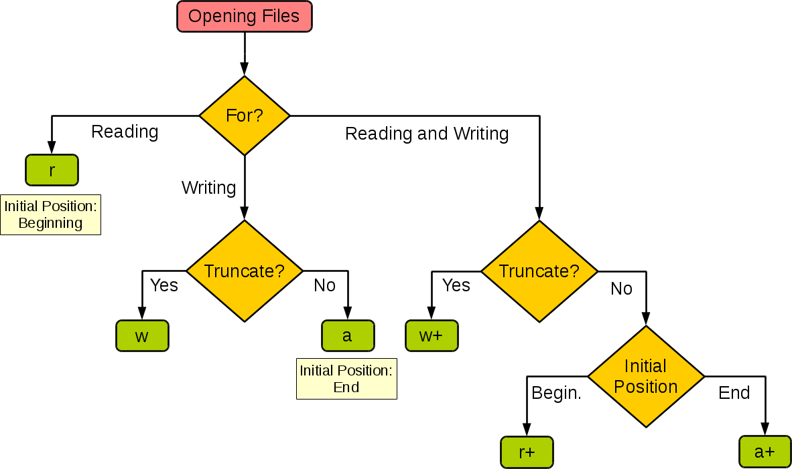
Decision branch

Slide 19
Delete file, folder
remove(file)
rmdir(dir)
rmtree(dir)
Import os
Import shutil
Delete an empty directory
Remove a non-empty directory
Delete a file

Slide 20
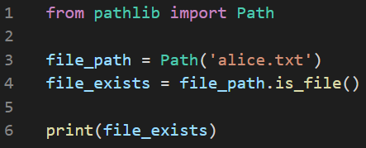
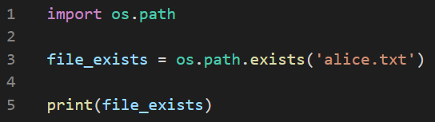
Check if file exists
Both ways return True if file exists, False otherwise

Slide 21
Exception handling
try – except blocks
For any error
For ZeroDivisionError exception
For FileNotFoundError exception
Falling silently
How to check if file exists using Exception handling?
try – except - else blocks
try – except - finally blocks

Slide 22
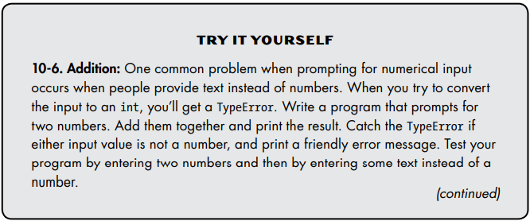

Slide 23
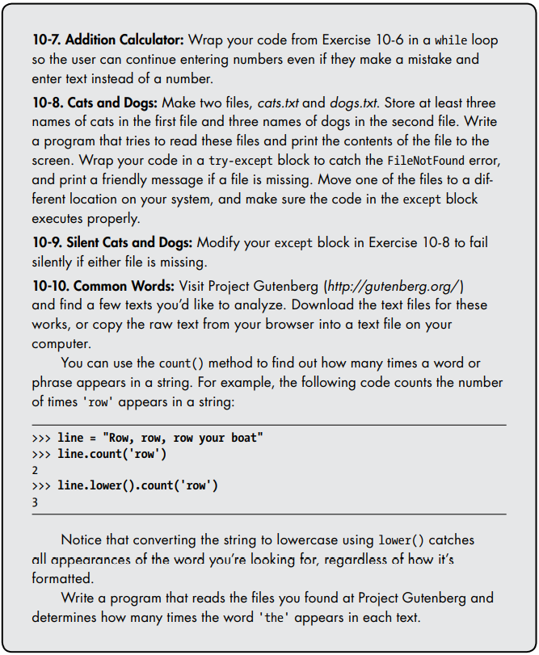

Slide 24
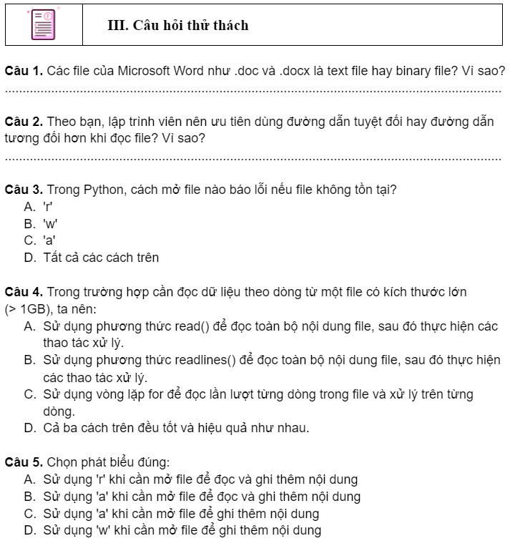
Challenge questions
Lab 12. Xử Lý File - Google Tài liệu

Slide 25
THANKS!
See you in the next lesson!
Please keep this slide for attribution.

